Slide 1
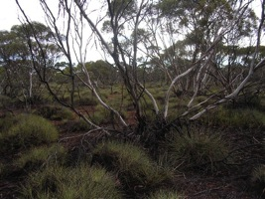
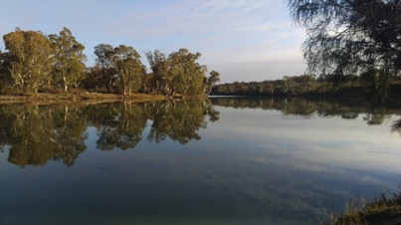
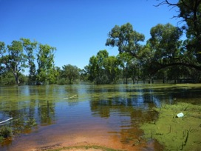
2015 South Australian State Landcare Conference
Conference Stream - Aboriginal Land Management
ABORIGINAL LANDS TRUST (ALT)
Aboriginal Land Management: A New Approach

Slide 2
Background…….
The Aboriginal Lands Trust has provided land management advice, advocacy, capacity building and financial support to Aboriginal Communities since its inception in 1966. The organisation has remained supportive of Community Councils with long term views of self-determination. The ALT has maintained a land management team for over 15 years gaining awards and recognition for their collaborative work with Communities.
In recent years ALT has maintained community participation and engagement in Landcare and NRM through partnerships with State and Federal agencies which have funded the delivery of the Aboriginal Learning on Country and Indigenous Protected Areas (IPA) programs. These programs have provided benefits of on-going training and employment.
The NRM climate is changing!

Slide 3
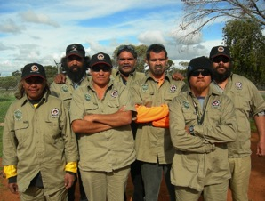
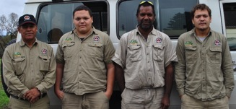
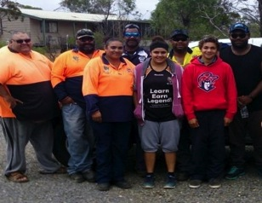
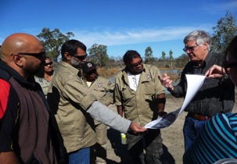
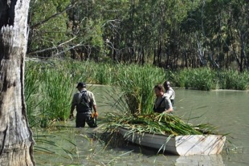
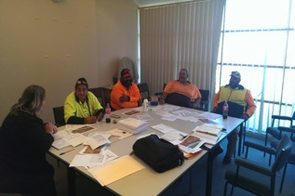
Aboriginal Learning on Country (ALOC) Program
2012-14 Kungun ALOC Team
One member joined the 2015 Gerard ALOC team and two members now leaders/mentors with the 2014-15 ALT AMLR ALOC team | ALT NRM Services team
2009-10 Gerard ALOC Team
2012-15 Gerard ALOC Team

Slide 4
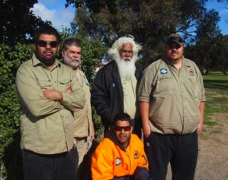
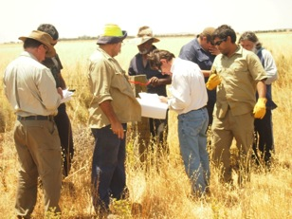
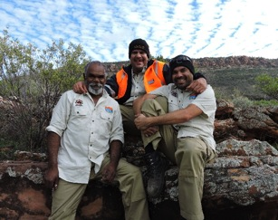
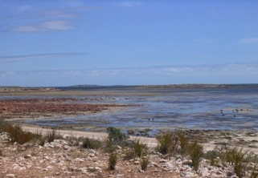
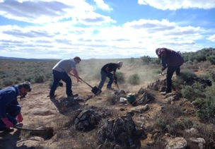
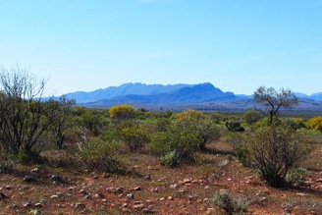
Indigenous Protected Areas (IPA) Program
2012-13 Point Pearce ALOC team two of which are now IPA Rangers
2013-15 Yappala IPA Rangers

Slide 5
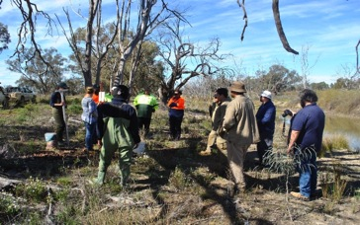
How is it changing you may ask?
Funding is the life blood of NRM services, delivered by:
Natural resources, Regional Boards;
Non government agencies;
Community organisation;
Licenced contractors;
And other government agencies.
Across the NRM landscape we have witnessed, over the past few years, a paucity of funds allocated for environmental care and management.
Caring for, and management of, the land and its resources is more complex, more human than monetary value alone; its about our relationships with each other; NRM is a peoples business!

Slide 6
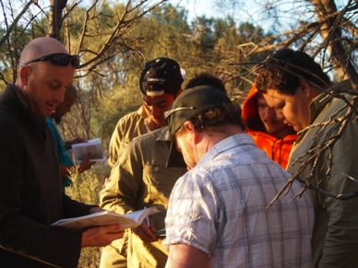
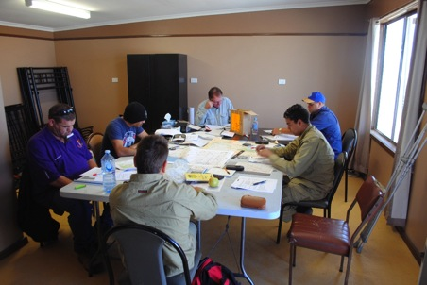
How has ALT has managed this change?
Relationships have been formed; caring for our employees, their welfare and future is vitally important. ALT wants to retain the time and effort spent on our staff and young trainees.
ALT has conducted a number of NRM traineeships in regional areas which has secured a core group of skilled and experienced NRM employees.

Slide 7
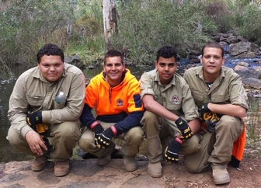
How has ALT managed this change? cont.…
Contracture of funds requires a new approach, a fresh perspective for service delivery. In some instances the previous model for the delivery of NRM services to Aboriginal Communities may have run its course!
An initial, new flexible, trained and skilled mobile team has been formed to pursue government and commercial contracts.
ALT has completed our first contracting team business plan, training and skills development are well advanced for our mobile team. Tendering for work is a new direction.
Contract discussions & negotiations have commenced with a number of clients.

Slide 8
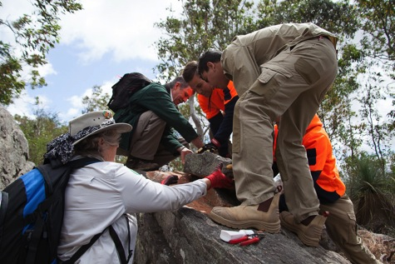
A New Approach….
Partnership between ALT & DEWNR established a team combining two long serving and experienced ALOC workers and two new trainees in October 2014.
ALT & DEWNR provided significant on-the-job experience which was conducted and targeted on public and private lands to give the team an insight into what is required to operate as a commercial NRM contracting team.
TafeSA | Aboriginal Access Unit provided the training with all team members achieving Cert III in & now undertaking Cert IV CLM & Indigenous Land Management.

Slide 9
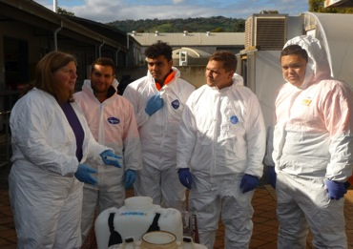
A New Approach cont….
ALT, DEWNR & TafeSA identified and pursued gaps in qualifications, tickets and licences required to operate as commercial NRM contracting team. i.e. Pest technician & Vertebrate pest licenses.
ALT & DEWNR investigated and implemented actions to ensure the team could be utilised as a commercial NRM contracting team i.e. Contractor Registers and Panels.
NR AMLR | DEWNR keen to support and work with ALT in the transition from ALOC team to a sustainable “enterprise” model i.e. “ALT NRM Service’.
ILC has also indicated they would also support the transition to a contractor model.

Slide 10
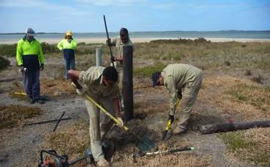
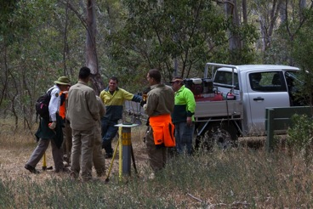
What this model offers….
All Aboriginal NRM team of enthusiastic young men with Cultural connections with Aboriginal Groups throughout SA.
Ability to work as a cohesive team and with a range of partner organisations & clients.
NRM qualified, experienced and skilled with significant on-the-job experience & training within the NRM Industry.
Track record of delivering quality work with a strong work ethic

Slide 11
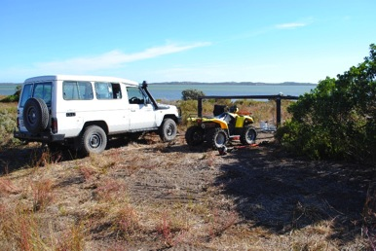
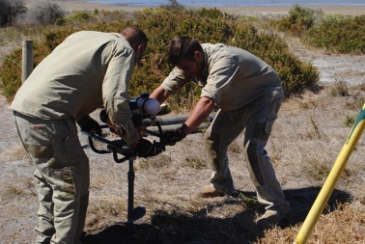
What this model offers cont…..
Resourced, flexible and mobile.
Managed and supported by an Aboriginal organisation & staff with many years of Landcare & NRM experience.
Operational & administrative support also provided by an Aboriginal organisation

Slide 12
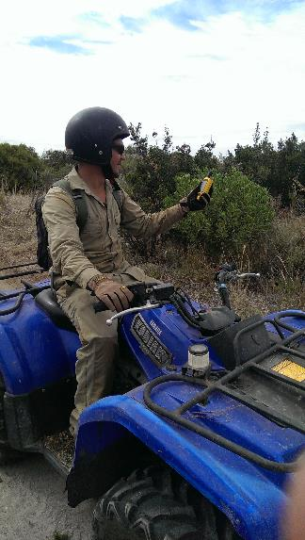
Current service provision…..
Weed control: Spaying, cut/swab, drill/fill and manual removal
Revegetation: tube stock planting, seed collection and direct seeding
Rural fencing, installation, repair & maintenance.
GPS mapping & monitoring; land condition, pests (plant & animal), native flora & fauna.

Slide 13
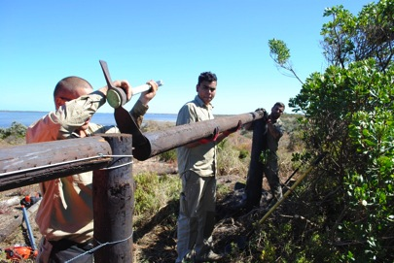
Current service provision…..
Track & walking trail maintenance and repair.
General Landscaping i.e. slashing, mowing & general infrastructure maintenance.

Slide 14
Para Wirra: Devil’s Nose Track Development
“Overall the team was a pleasure to work with and in this and other tasks have proved to be independent and reliable once they understand a task.
A combination of learning the necessary skills, learning to use hand tools effectively, observing and working with the lay of the land is all required to maintain trails. The AMLR ALOC team got their heads around all of this and embraced the task with enthusiasm. They achieved the goal of fully maintaining the trail section well within the week that was allocated and in the process scoured the adjacent hillside for boneseed weeds that were cut and swabbed or hand pulled.”
Steve Taylor, Senior Ranger Para Wirra

Slide 15
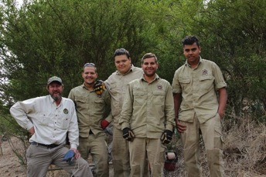
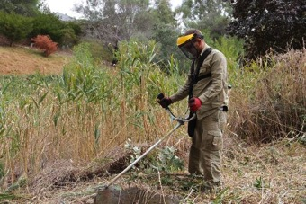
Highbury Aqueduct: track development & weeding
“Being able to use the ALOC team on the Highbury site has been of great benefit to the project. Jobs they have undertaken include, building a post and wire fence around a culvert, cut and swabbing olives and blackberry, cutting up fallen trees and removing 100 meters of chain wire fencing.
The team all get along very well with each other and DEWNR staff which makes working with them an enjoyable experience.”
Dave Fraser, Project Officer Highbury Aqueduct

Slide 16
Moving forward……
We the ALT are treading new ground and forging a new path in the way we think and will operate in the competitive NRM industry.
In order to meet those needs the ALT with foresight and strategic planning has the support of ALT management and our primary stakeholders to continue to foster, train and develop a skilled, motivated and proud Aboriginal NRM workforce to undertake commercial activities and sustainable contracts.
THANK YOU

